Slide 1
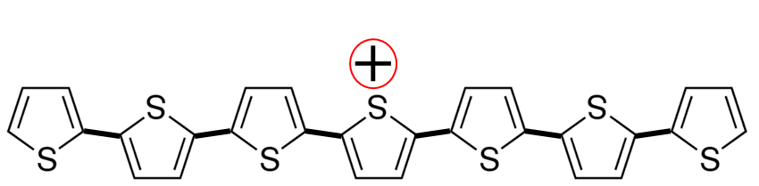
Modelling the Holstein Hamiltonian with multiparticle basis set
P3HT backbone
t_{intrachain}
(1,1)
(1,2)
(1,3)
(1,4)
(1,5)
(1,6)
(1,7)
LUMO
HOMO
Here is an example of an oxidized polymer (P3HT) backbone. The hole resides on the 4th thiophene unit while all the remaining thiophene units in the chain have doubly occupied HOMO. The alkyl chains are not shown for clarity. The HOMOs of the neighboring thiophene units are electronically coupled via the hole transfer integral (t_{intrachain}). As a result the hole can easily delocalise from one side of the chain to the other side.

Slide 2
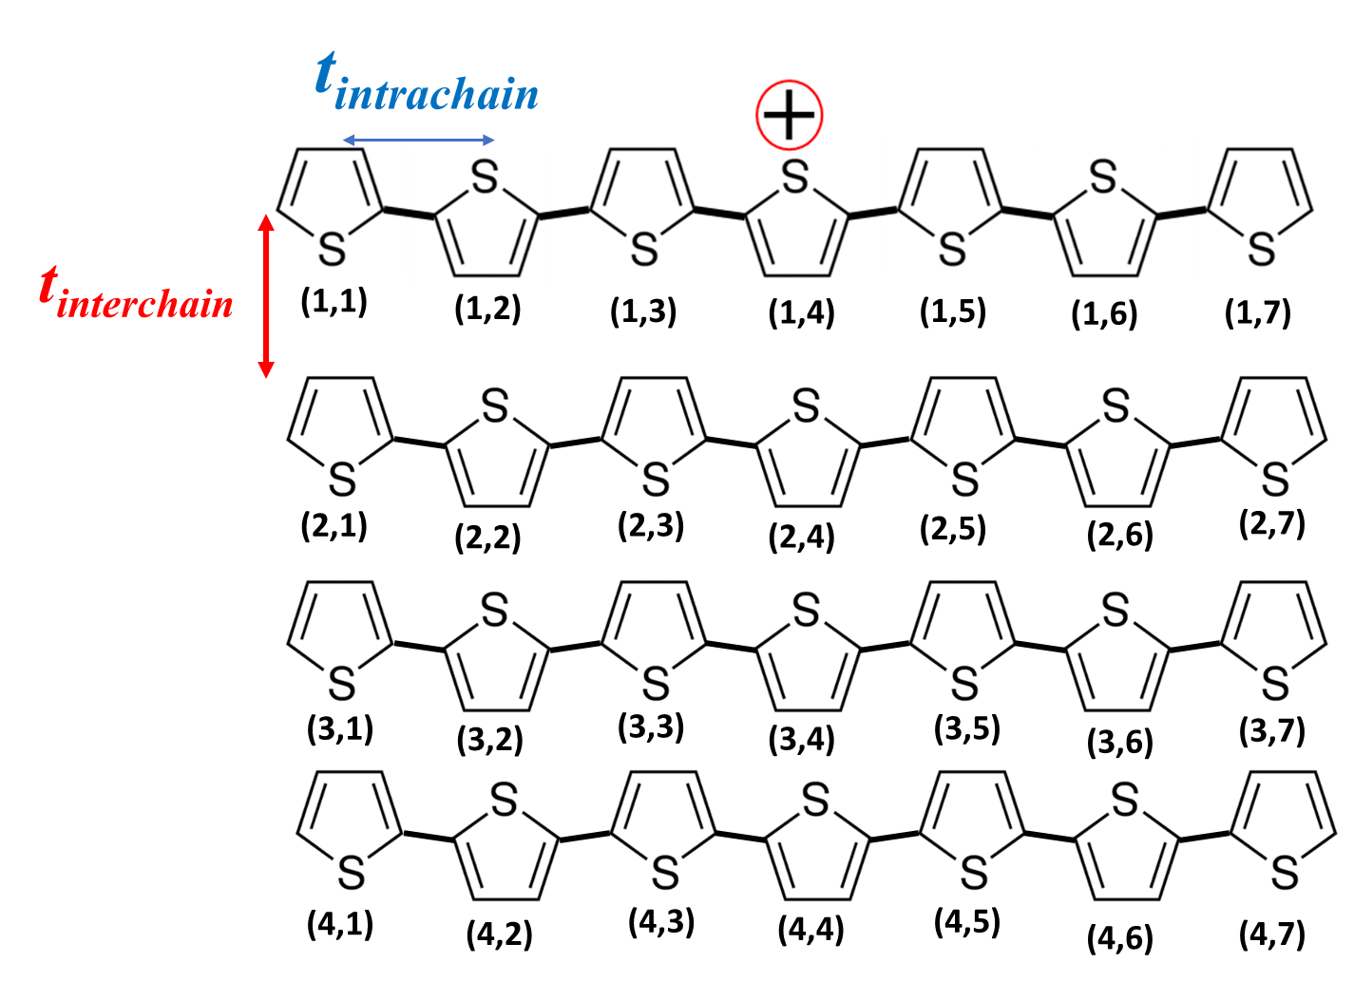
Modelling the Holstein Hamiltonian with multiparticle basis set
In the semicrystalline phase, P3HT films exhibit lamellar packing in which the thiophene backbones form p-stacks. As the p-stacking distances are only 0.35-0.40 nm apart; interchain interactions play a significant role in polaron and exciton transport in polymer aggregates. There is convincing evidence of two dimensional polaron delocalization in literature; both along the polymer backbone and in between chains.
Subroutine call indexlattice()
We model the P3HT stack as a two dimensional aggregate. This subroutine in the code indexes every thiophene unit in the polymer stack as shown in the figure. (2,3) refers to the third thiophene unit in the second chain.
Polymer Stack

Slide 3
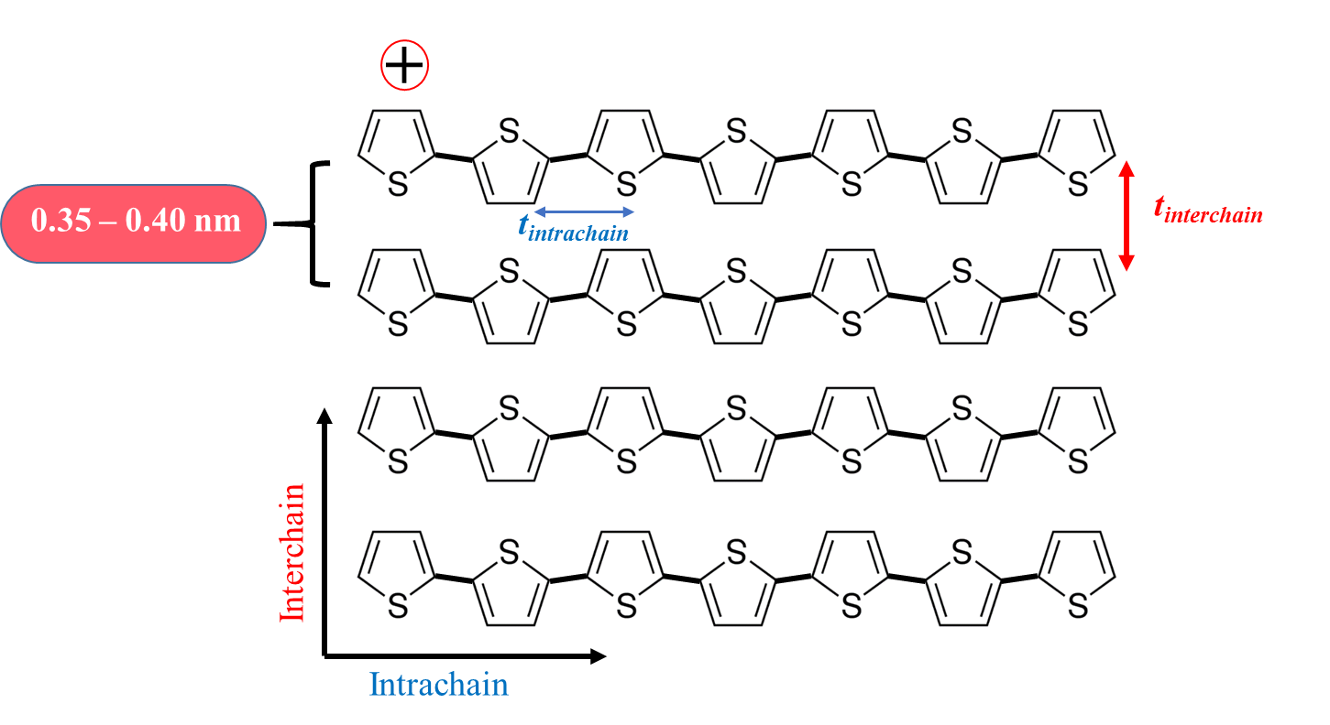
Modelling the Holstein Hamiltonian with multiparticle basis set
The first two terms in the Hamiltonian represent the electronic coupling along and across the chains. The hole can delocalize both along the polymer backbone and in between chains; which is dictated by the values of t_{intrachain} and t_{interchain}. For detailed explanation, please look into the reference given below.
t_{intrachain}
+
+
Hole transfer:
Schematic showing hole/charge transfer between neighboring units

Slide 4
Optical excitations in Non-rigid Molecules:
Displaced Oscillators
Huang-Rhys factor:
1¹B_{u} (S₁)
0-0
1-0
Absorption
2-0
0-0
3-0
2-0
0-1
1-0
0-2
1¹A_{g} (S₀)
energy
0-0
Franck-Condon Factors:

Slide 5

Modelling the Holstein Hamiltonian with multiparticle basis set
The Multi-particle Basis Set for Holes
The basis set used to represent the Hamiltonian is truncated to include the one particle states and two particle states.
One particle basis set
+
In the one particle basis set denoted as , the hole resides on the m^{th} thiophene monomer on the n^{th} chain with vibrational quantum in the shifted potential well. The remaining N²-1 thiophene units in the stack are in their vibrationless ground states. So in the figure shown above represents a hole residing on the 4th thiophene unit of the first chain with 2 vibrational quanta.

Slide 6
Two particle basis set
+
In the two particle basis set denoted as , the monomer (m,n) is ionized with vibrational quanta in the shifted potential while monomer is electronically neutral with vibrational quanta in the unshifted potential well. represents a hole residing in the 4th thiophene unit of the 1st chain having two vibrational quanta
while the 6th thiophene unit of the 1st chain is vibronically (not electronically) excited with 1 vibrational quanta.
We can also include three particle states where one thiophene unit is both vibrationally and electronically excited while two other thiophene units in the stack are vibrationally excited.

